Slide 1
COMMUNITY CONNECT WITH TRAINED NCC
PS ID : GS906
TEAM NAME : ELITE HACKERS

Slide 2
NCC CONNECT
The main objective of NCC Connect is to provide a user-friendly interface for the NDRF to connect with trained NCC volunteers. It works on the strategy of ON A CLICK, ALL CONNECTS ARE ACTIVATED. Once the details are fed into the system or computer there is no need for various persons to deal with separate sections. The security can also be given as per the requirements.
High volumes of data can be stored .
Maintenance of file is efficient and flexible.
Records are always updated.
Edition of stored data and procedure can be easy.
Manpower is reduced.

Slide 3
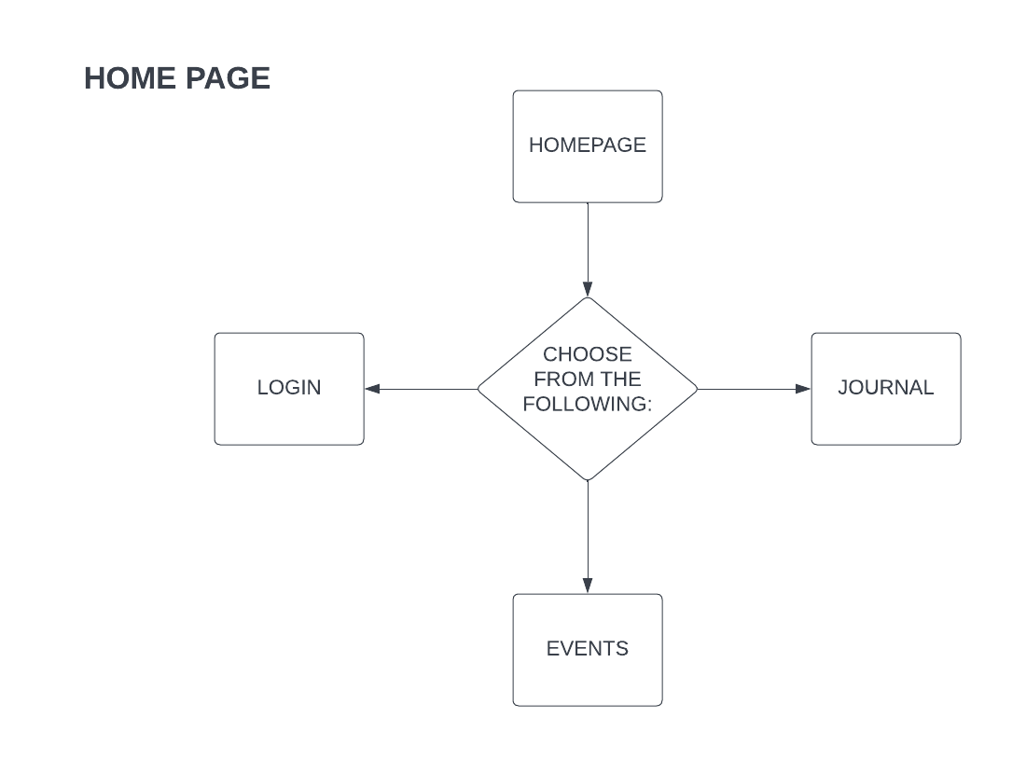

Slide 4
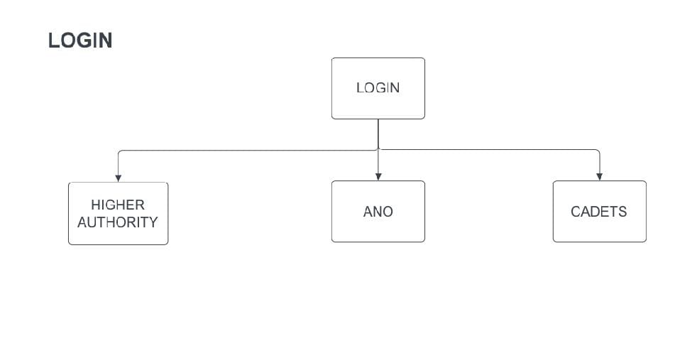

Slide 5
HIGHER AUTHORITY
Higher authority has all the access rights to the system. Higher authority includes the NDRF officials, DG NCC, Directorates, Groups and the Units. Higher Authorities is able to manage the ANOs registration, notification gateway, events and journals. This access is forbidden for the rest of the users. They can manage the account of all the ANOs and can all also view all the cadets information. They are able to send Notifications and upload some requirements related to the disaster occurred to all the ANOs and Cadets through a single click.

Slide 6
WORKFLOW
Start
Login
Add/delete ANO
View/Edit ANO
View Cadets information
Manage Notifications
Manage Events
Manage Journals
Logout
Stop

Slide 7
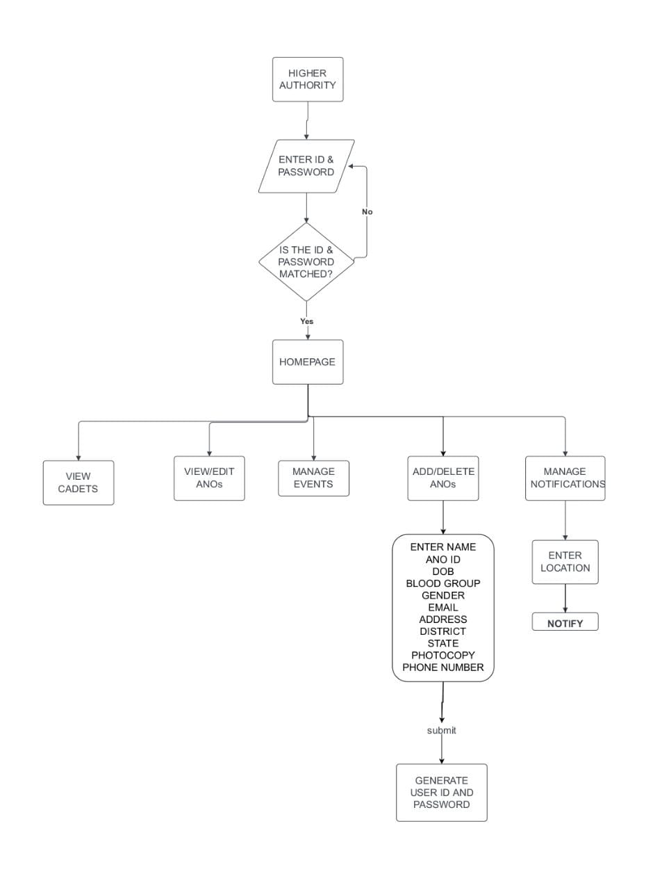
HIGHER AUTHORITY
LOGIN PAGE

Slide 8
ASSOCIATE NCC OFFICER ( ANO)
Associate NCC Officer ( ANO ) are registered by higher authorities and login details are generated by higher authorities which can be managed by ANOs later. ANOs are responsible for the Cadets registration . ANOs have access rights to manage all the data of the cadets .

Slide 9
WORKFLOW
Start
Login
Add/Delete Cadets
View/Edit Cadets information
Add notes
Logout
Stop

Slide 10
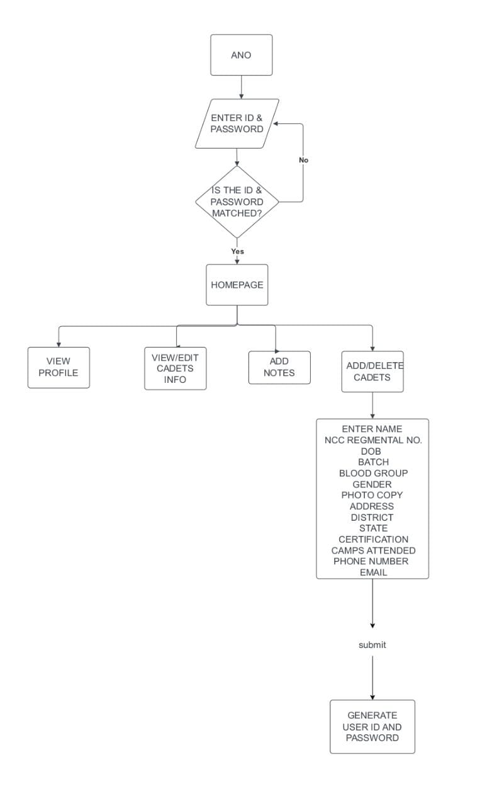
ANO LOGIN PAGE

Slide 11
CADETS
Cadets are admitted by the ANOs only to the system. When they got admitted , the user id and passwords are generated by ANOs and can be managed by Cadets afterwards. Cadets have access to their personal profile, Upcoming Events and all the notifications.

Slide 12
WORKFLOW
Start
Login
View Profile
View Notice board
Logout
Stop

Slide 13
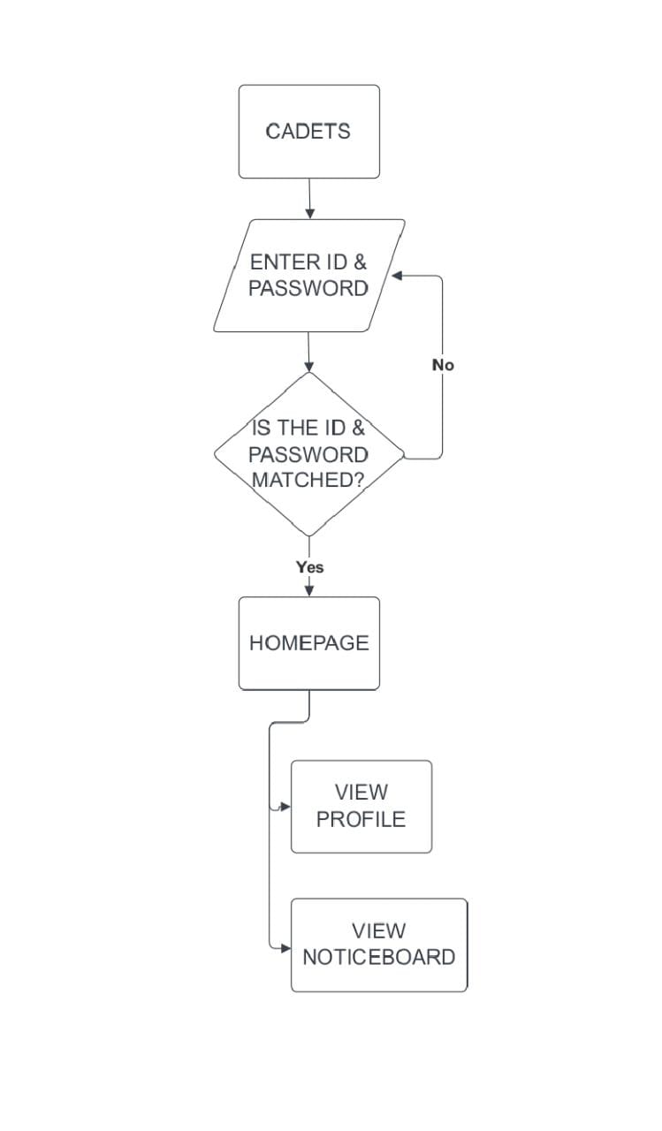
CADETS
LOGIN PAGE

